Slide 1

SQL PIZZA Sales PROJECT

Slide 2




Hello !
Abhinesh Kumar Jaiswal is my name. In my SQL Pizza Sale Project, I used SQL queries to find answers to questions about pizza sales.

Slide 3




RETRIEVE THE TOTAL NUMBER OF ODERS PLACED
SELECT COUNT(order_id) AS Total_Number_of_Orders
FROM "order";
RESULT
Total_Number_Of_order
21350
7572026319
Jaiswalabhinesh160@gmail.com

Slide 4
CALCULATED TOTAL REVENUE FROM PIZZA SALES
SELECT ROUND(SUM(pizzas.price * Order_Details.quantity), 2) AS Total_Revenue
FROM Order_Details
JOIN pizzas
ON pizzas.pizza_id = Order_Details.pizza_id;
RESULT
Total_Reveneue
2408332.35
7572026319
Jaiswalabhinesh160@gmail.com

Slide 5
IDENTIFIDE THE MOST COMMON PIZZA SIZE ORDER
SELECT pizzas.size, COUNT(Order_Details.order_details_id) AS Orders
FROM pizzas
JOIN Order_Details
ON pizzas.pizza_id = Order_Details.pizza_id
GROUP BY pizzas.size
ORDER BY Orders DESC
LIMIT 1;
RESULT
Size = l
Orders = 55578
7572026319
Jaiswalabhinesh160@gmail.com

Slide 6
IDENTIFIDE THE HIGHEST PRICE OF PIZZA
SELECT pizza_types.Pizza_name, pizzas.price
FROM pizza_types
JOIN pizzas
ON pizzas.pizza_type_id = pizza_types.pizza_type_id
ORDER BY pizzas.price DESC
LIMIT 1;
RESULT
Pizza_Name =
The Brie Carre Pizza
Price =23.65
7572026319
Jaiswalabhinesh160@gmail.com

Slide 7

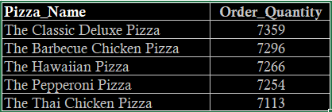
LIST TOP 5 MOST ORDERED PIZZA TYPE ALONG WITH THIER QUANTITIES
SELECT pizza_types.Pizza_name, SUM(Order_Details.quantity) AS Order_Quantity
FROM pizza_types
JOIN pizzas ON pizzas.pizza_type_id = pizza_types.pizza_type_id
JOIN Order_Details ON pizzas.pizza_id = Order_Details.pizza_id
GROUP BY pizza_types.Pizza_name
ORDER BY Order_Quantity DESC
LIMIT 5;
Result

Slide 8
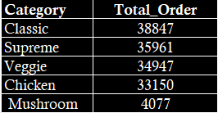
JOIN THE NECESSARY TABLE TO FIND THE TOTAL QUANTITY OF EACH PIZZA CATEGORY ORDERED
SELECT pizza_types.category, SUM(Order_Details.quantity) AS Total_Order
FROM pizza_types
JOIN pizzas ON pizzas.pizza_type_id = pizza_types.pizza_type_id
JOIN Order_Details ON pizzas.pizza_id = Order_Details.pizza_id
GROUP BY pizza_types.category
ORDER BY Total_Order DESC;
Result

Slide 9
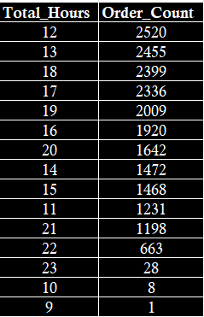
DETERMINE THE DISTRIBUTION OF ORDERS BY HOUR OF THE DAY
SELECT Total_hours, COUNT(order_id) AS OrderCount
FROM "order"
GROUP BY Total_hours
ORDER BY OrderCount DESC;
Result

Slide 10
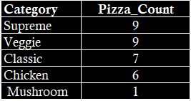
JOIN THE RELEVENT TABLES TO FIND CATEGORY WISE DISTRUBUTION PIZZA
SELECT category, COUNT(Pizza_name) AS Pizza_count
FROM pizza_types
GROUP BY category
ORDER BY Pizza_count DESC;
Result

Slide 11
GROUP THE ORDER BY DATE AND CALCULATE THE AVERAGE NUMBER OF PIZZA ORDERED PER DAY
SELECT AVG(quantity) AS avg_Pizza_order_perDay
FROM (
SELECT "order".date, SUM(Order_Details.quantity) AS quantity
FROM "order"
JOIN Order_Details
ON "order".order_id = Order_Details.order_id
GROUP BY "order".date
) AS order_quantity;
Result
Average_Pizza_Order_Per_Day = 138

Slide 12
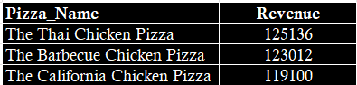
DETERMINE THE TOP 3 MOST ORDERED PIZZA TYPE BASED ON REVENUE
SELECT pizza_types.Pizza_name, SUM(Order_Details.Total_Amount) AS Revenue
FROM pizza_types
JOIN pizzas ON pizzas.pizza_type_id = pizza_types.pizza_type_id
JOIN Order_Details ON Order_Details.pizza_id = pizzas.pizza_id
GROUP BY pizza_types.Pizza_name
ORDER BY Revenue DESC
LIMIT 3;
Result

Slide 13
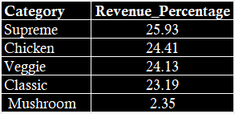
CALCULATE THE PERCENTAGE CONTRIBUTION OF EACH PIZZA TYPE TO TOTAL REVENUE
SELECT pizza_types.category,
ROUND(SUM(Order_Details.quantity * pizzas.price) /
(SELECT SUM(Order_Details.quantity * pizzas.price)
FROM Order_Details
JOIN pizzas ON pizzas.pizza_id = Order_Details.pizza_id) * 100, 2) AS revenue
FROM pizza_types
JOIN pizzas ON pizza_types.pizza_type_id = pizzas.pizza_type_id
JOIN Order_Details ON Order_Details.pizza_id = pizzas.pizza_id
GROUP BY pizza_types.category
ORDER BY revenue DESC;
Result

Slide 14
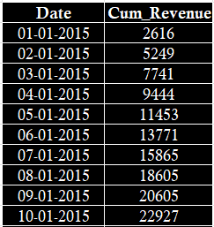
ANALYZE THE CUMULATIVE REVENUE GENERATED OVER TIME
SELECT date,
SUM(Revenue) OVER (ORDER BY date) AS Cum_revenue
FROM SELECT "order".date,
SUM(Order_Details.Total_Amount) AS Revenue
FROM "order" JOIN Order_Details
ON "order".order_id = Order_Details.order_id
GROUP BY "order".date) AS Sales
ORDER BY date LIMIT 10;
Result

Slide 15
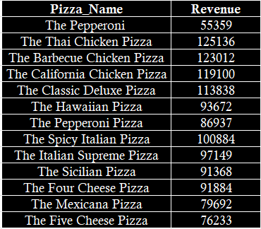
DETERMINE THE TOP 3 MOST ORDERED PIZZA TYPE BASED ON REVENUE FOR EACH PIZZA CATEGORY
SELECT Pizza_name, Revenue FROM (SELECT category, Pizza_name, Revenue,
RANK() OVER (PARTITION BY category ORDER BY Revenue DESC) AS Rank
FROM (SELECT pizza_types.category, pizza_types.Pizza_name,
SUM(Order_Details.Total_Amount) AS Revenue FROM pizza_types JOIN pizzas ON
pizza_types.pizza_type_id = pizzas.pizza_type_id JOIN Order_Details ON
pizzas.pizza_id = Order_Details.pizza_id GROUP BY
pizza_types.category, pizza_types.Pizza_name ) AS Subquery_A) AS B WHERE Rank <= 3;
Result

Slide 16
thank you!

